Slide 1
EMOTION DETECTION
- Runtime Error

Slide 2
MEET THE TEAM
YATHARTH SINGH (20BAI10073)
NITYA BANSAL (20BAI10348)
KANAK MAHESHWARI (20BAI10179)

Slide 3
DIVISION
1. FACE DETECTION
2. EMOTION RECOGNITION

Slide 4
Face Detection
Face detection also called facial detection is an artificial intelligence (AI) based computer technology used to find and identify human faces in digital images.
Face Detection is an application software to deal with human face.This software helps the people looking for more advanced way of image processing system.
Using this software, they can easily find or detect faces in image and also recognize the face after saving that. Face-detection algorithms focus on the detection of frontal human faces.
It is analogous to image detection in which the image of a person is matched bit by bit.

Slide 5
Emotions & Emotion Detection
Human emotions can be broadly classified as: fear, disgust, anger, surprise, sad, happy and neutral. The reconstruction of facial muscles is not very important, and this separation may be very difficult as even small comparisons bring about various expressions. Similarly, the expressions of people who are different or of the same can change into the same feeling, since the emotions are very much dependent on the context. Although focusing only on those facial expressions that reflect the abundance of emotions such as the mouth and eyes, how these symptoms are expressed and organized is still an important question. Neural networks and machine learning use these bonds and get good results. Machine learning statistics have shown that they are very useful in the acceptance of design and order, and from now on they can be used to determine attitudes.

Slide 6
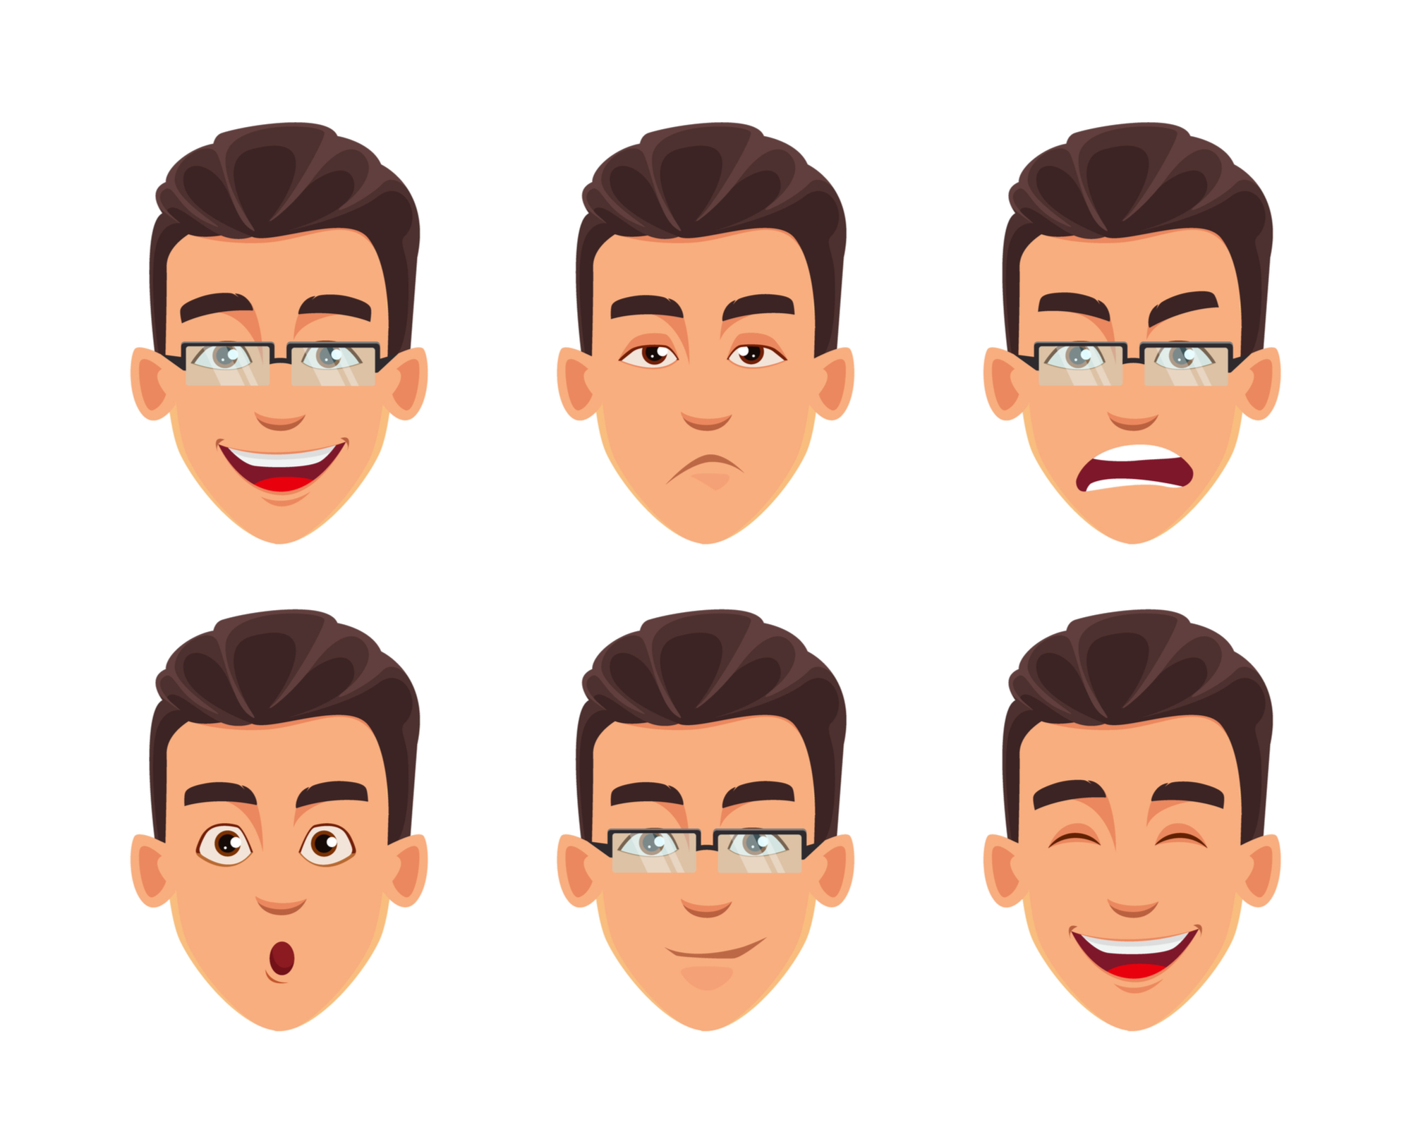

Slide 7
Existing Work
A patent filed by Snapchat in 2015 describes a method of extracting data about crowds at public events by performing algorithmic emotion recognition on users' geotagged selfies
Emotient was a startup company which applied emotion recognition to reading frowns, smiles, and other expressions on faces, namely artificial intelligence to predict "attitudes and actions based on facial expressions". Apple bought Emotient in 2016 and uses emotion recognition technology to enhance the emotional intelligence of its products.
nViso provides real-time emotion recognition for web and mobile applications through a real-time API. Visage Technologies AB offers emotion estimation as a part of their Visage SDK for marketing and scientific research and similar purposes.

Slide 8
Hardware & software requirements
4 GB RAM (Minimum)
80 GB HDD
Dual Core processor
CDROM (installation only). VGA resolution monitor
Microsoft Windows 98/2000/NT with service pack 6 / XP with service pack 2/ Windows 7 with service pack 2
SQL Server 2008 R2

Slide 9
ARCHITECTURE
FACE
WEBCAM
FRAME SEPARATION
PREPROCESSING
FACE DETECTION
EXPRESSION RECOGNITION

